Slide 1

Java + Mobile course by Enered

Slide 2
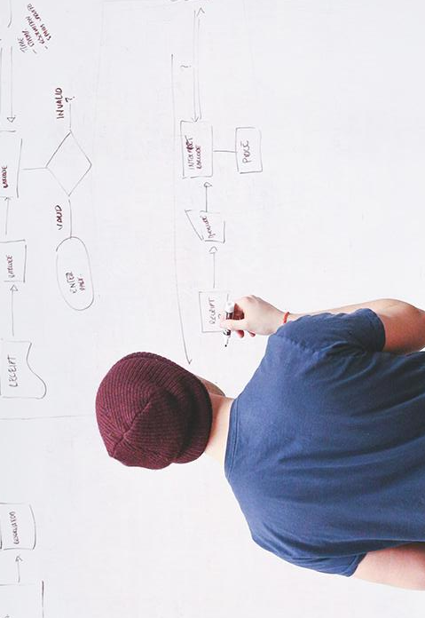
HELLO!
I am Vlad Butnaru
I will be your trainer for this Java session!
PS: It’ll be awesome!

Slide 3
What will we do today
Collections (ArrayList)
Restaurant Table Management System

Slide 4
Collections (ArrayList)
Are cooler than plain Arrays (vectors)
Are much more optimized
Are used in EVERY Java application
Better than any other Collections implementation (except from Map)
Are the basis of BigData manipulation
Are lighting fast

Slide 5
Usage
ArrayList<String> strings = new ArrayList<String>();
strings.add(“test”);
strings.get(0) // index
strings.remove(0) //index
strings.clear();
strings.indexOf(“test”);
strings.isEmpty();
strings.size();

Slide 6
DEMO

Slide 7
Restaurant Table Management System
Greg has a restaurant with 4 tables. He wants to accept customers. Each customer may choose what table he wants (1,2,3 or 4). At one table, there can be only one customer at a time. He wants an application that has a menu like the following:

Slide 8
Menu
1. Customer – check free tables
2. Customer – reserve a table
3. Customer – leave restaurant
4. Admin – view most popular table
5. Admin – view each table history
6. Exit

Slide 9
THANKS!
Any questions?
You can find me at:
@web: http://vladbutnaru.com/
@facebook· Vladut Butnaru
@linkedin· Vlad Butnaru
@email : vlad2me@gmail.com
@phone : +40 0754 827 620

Slide 10
Feedback please!
http://bit.do/feedbackvlad

